Slide 1
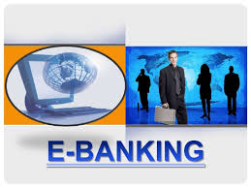
Class :III Sem B.Com Tax LIGI JOLLY
Subject :IT in Business ASSISTANT PROFESSOR
DEPARTMENT OF COMMERCE
N.S.S. COLLEGE PANDALAM

Slide 2
CONCEPT of INTERNET BANKING
It is a system that provides the facility to the customers to conduct the financial and non financial transactions from his home, with out physically visiting the bank.
Also known as personal banking-internet banking-virtual banking-home banking…etc

Slide 3
Characteristics
Removal of traditional geographic barrier
Provision of online banking services
Ensures security of banking transactions
Reduces the risk of loss of business
Saves time

Slide 4
E-banking Models
Information only system
Electronic information transfer system
Fully electronic transactional system

Slide 5
E-Banking Services
Bill payment services
Online Fund Transfer
Credit card Loans
Online Ticketing
Investments
Payments
Online shopping
Customer care

Slide 6
E-Banking Products
Debit card-It is a plastic card allows the customers to use funds against his balance in the account.
Credit cards: It is a plastic card allows the customer to buy goods and services based on his promise to pay for these goods and services
Smart cards: A card with embedded integrated circuits.
E-cash: Money or scrip exchanged only electronically.

Slide 7
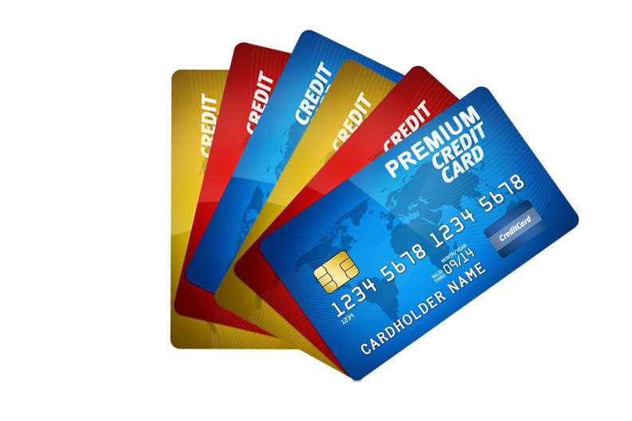
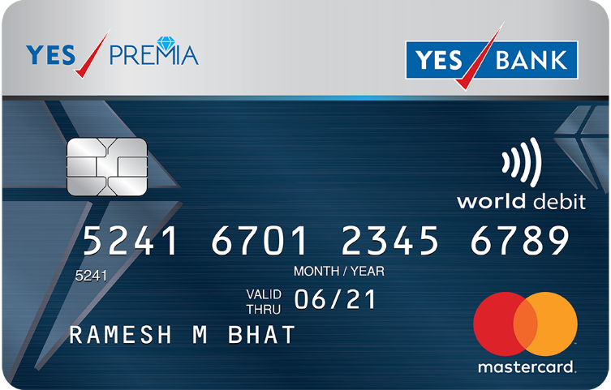
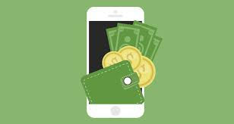

Slide 8
Automated Teller Machine (ATM)
An Automated teller machine (ATM) is an electronic telecommunications device that enables customers of financial institutions to perform financial transactions such as cash withdrawals, deposits, transfer funds, or obtaining account information, at any time and without the need for direct interaction with bank staff.

Slide 9
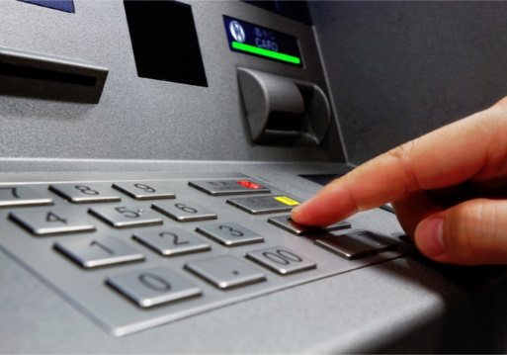
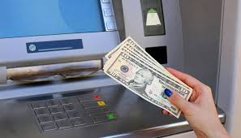

Slide 10
Mobile Banking
Mobile banking is a service provided by a bank or other financial institutions that allows its customers to conduct financial trasnscations remotely using a mobile devices such as a smart phones or tablet

Slide 12
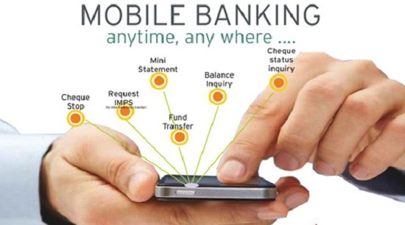
Benefits of E-Banking
Simple to use
Less cost
Easy to view account
Balanced account
Any time access
Convenience
E-Banking products
Core Banking

Slide 13
Limitations of E-Banking
Availability of Internet facility
Knowledge regarding the operation of E-banking
Bank charges
Security threats
Hacking
Lack of flexibility in systems

Slide 14
Traditional Banking Vs. E-Banking

